Slide 1

Tutorial Project
By PIERRE Tom / MANOHARAN Anushan / PARISOT Theo / GIANNICO Raffaele

Slide 2
Summary :
Introduction
Work implemented
To do
Conclusion

Slide 3
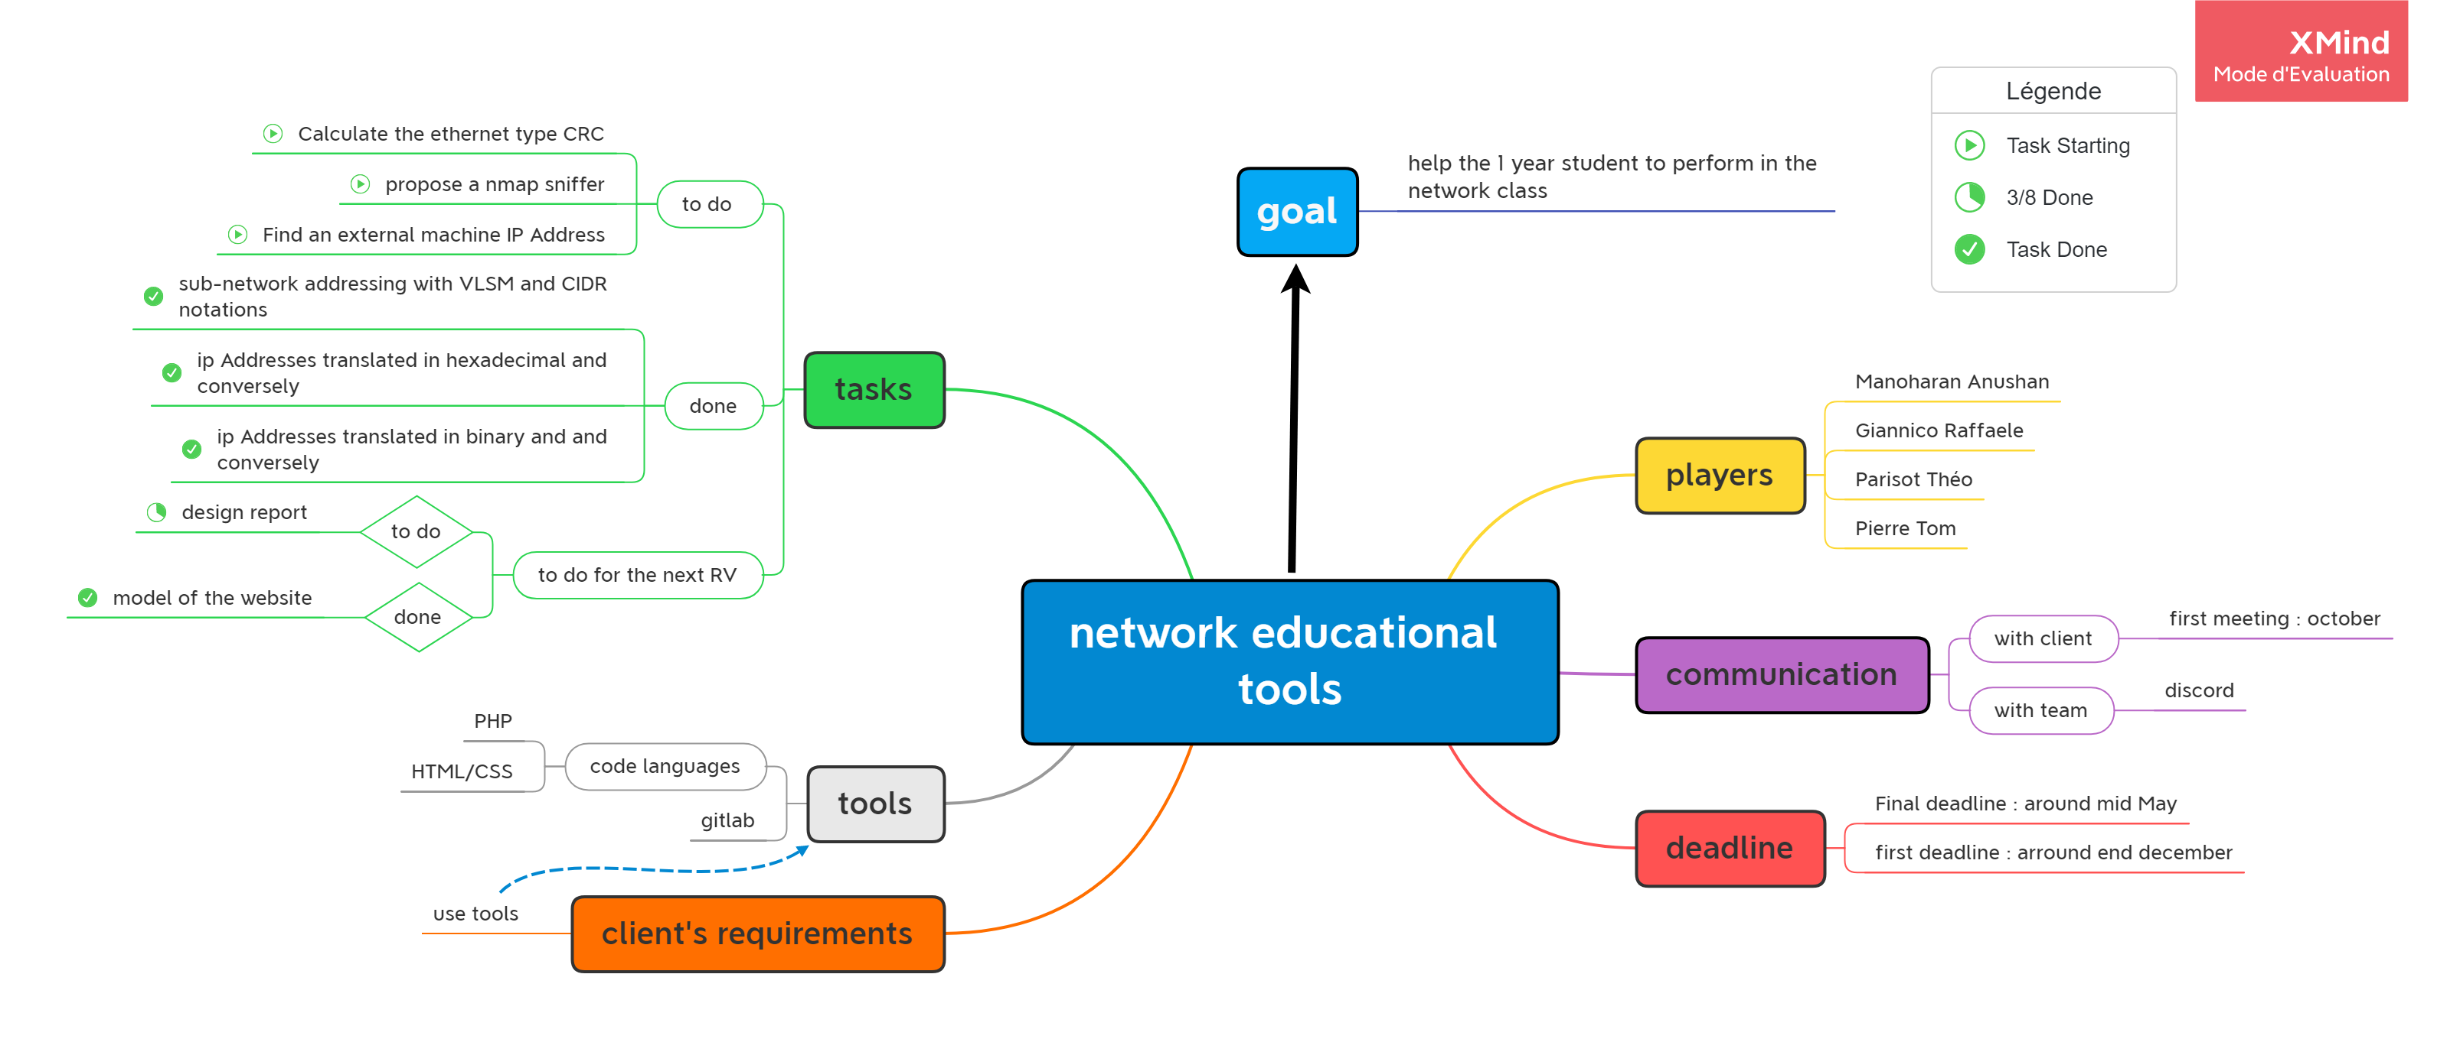
Introduction
Work done main page hex to dec bin to dec sub network
To do
Conclusion
Introduction​
Work implemented
Main page
Bin to dec
Hex to dec
Sub network
Design report
To do ​
Conclusion ​
Introduction

Slide 4





Introduction​
Work
implemented
Main page
Bin to dec
Hex to dec
Sub network
Design report
To do ​
Conclusion ​
Introduction
help the 1st year students to perform in the network class
-GIANNICO Raffaele
- PIERRE Tom
- MANOHARAN Anushan
- PARISOT Theo
october / november

Slide 5



Introduction​
Work
implemented
Main page
Bin to dec
Hex to dec
Sub network
Design report
To do ​
Conclusion ​
Introduction
Model of the website + some of functionalities
project completed + client's requirement met
- end of December
- mid may
Tools :

Slide 6
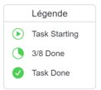
Introduction​
Work
implemented
Main page
Bin to dec
Hex to dec
Sub network
Design report
To do ​
Conclusion ​
Introduction

Slide 7
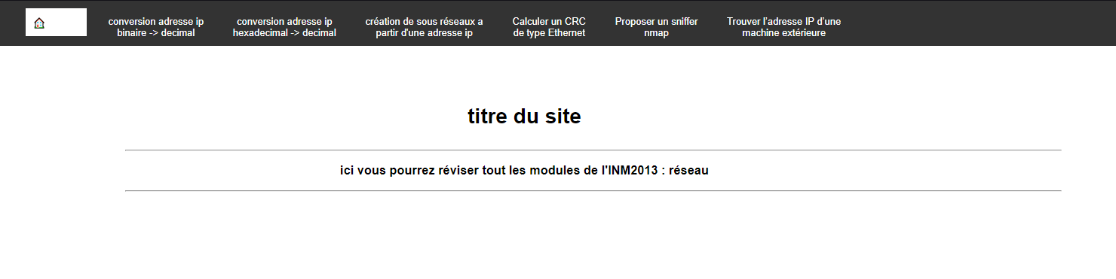
Introduction​
Work
implemented
-> Main page
Bin to dec
Hex to dec
Sub network
Design report
To do ​
Conclusion ​
Work implemented
Main Page
Adresse IP :
Bin -> dec
Hex -> dec
Sous - réseau
Trouver IP autre machine
Calculer le CRC
Sniffer Nmap

Slide 8
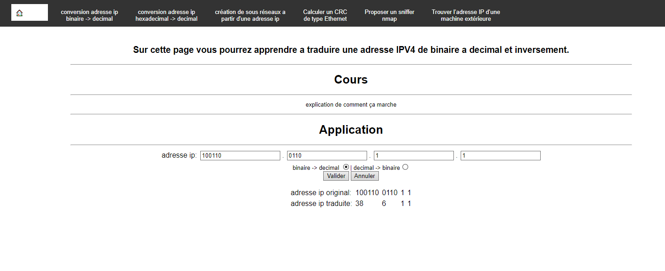

Introduction​
Work
implemented​
Main page
-> Bin to dec
Hex to dec
Sub network
Design report
To do ​
Conclusion ​
Work implemented
Bin to dec
100110
0110
1
1

Slide 9
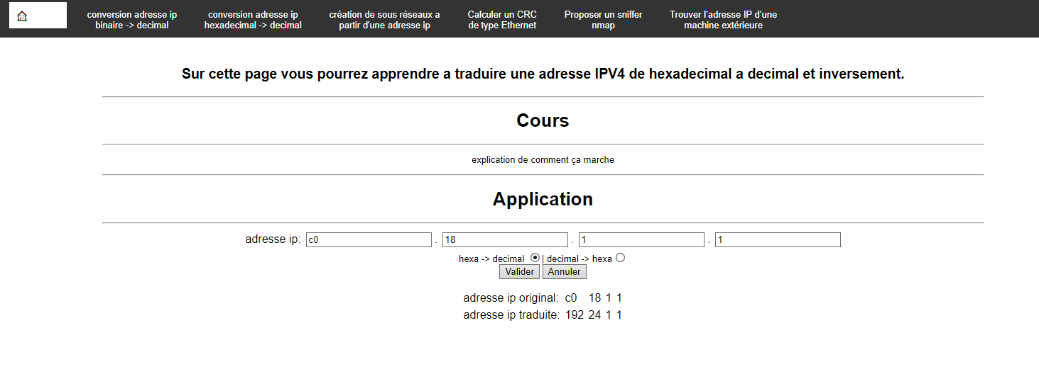
Introduction​
Work
implemented​
Main page
Bin to dec
-> Hex to dec
Sub network
Design report
To do ​
Conclusion ​
Work implemented
hex to dec
Hexadecimal to decimal
C0.18.1.1
192.168.1.1
Decimal to Hexadecimal

Slide 10
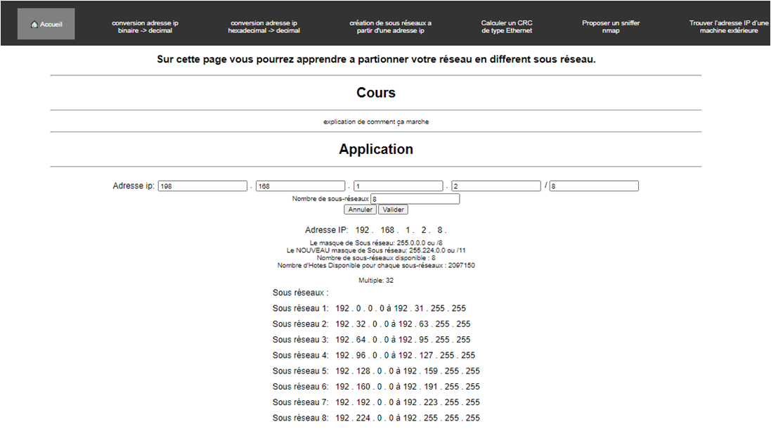
Introduction​
Work
implemented​
Main page
Bin to dec
Hex to dec
-> Sub network
Design report
To do ​
Conclusion ​
Work implemented
Sub network

Slide 11


Introduction​
Work
implemented​
Main page
Bin to dec
Hex to dec
Sub network
-> Design report
To do ​
Conclusion ​
Work implemented
Design Report
Have we understood ?
Annex 2
Introduction
Project
Question
Use case
Annex
Annex 1

Slide 12

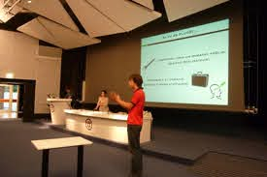
Introduction​
Work
implemented
Main page
Bin to dec
Hex to dec
Sub network
Design report
To do ​
Conclusion ​
To Do
1.
2.
3.

Slide 13
Introduction​
Work
implemented​
Main page
Bin to dec
Hex to dec
Sub network
Design report
To do ​
Conclusion ​
Conclusion
University
Project
50%
50%
Thank you !
and do not hesitate to ask questions !

